Slide 1

Metric Optimization and Mainstream Bias Mitigation in Recommender Systems
Roger Zhe Li

Slide 2
Preliminaries

Slide 3
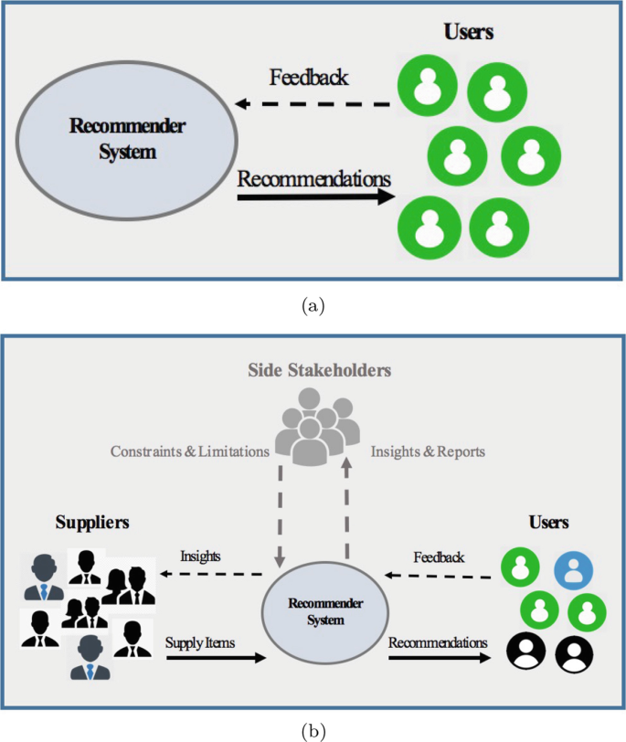
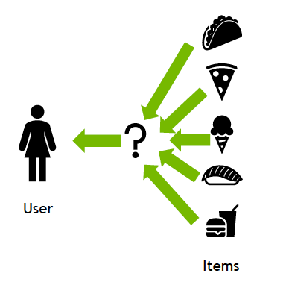
Recommender Systems: Multi-stakeholder and Users

Slide 4
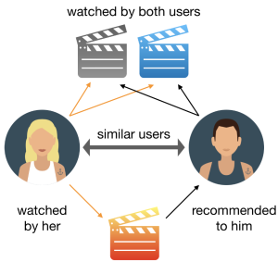
Recommender Systems: How It Works

Slide 5
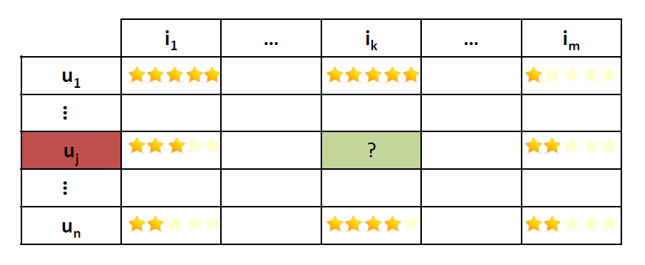
Recommender Systems: Traditional View
Objects (e.g., movies, products)
Users
Sparse matrix: Most values are unknown
Predicting: The task of filling the unknown values

Slide 6
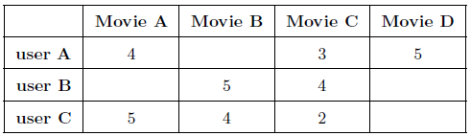
Recommender Systems as a Matrix Filling Task
Infer user preferences about items
Produce highly relevant & personalized lists of items
items
rating: level of preference
users
unknown preferences
ratings matrix

Slide 7
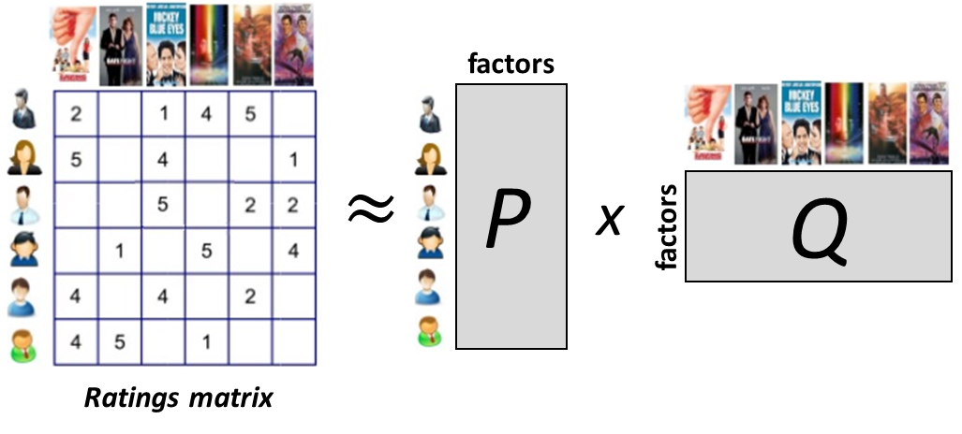
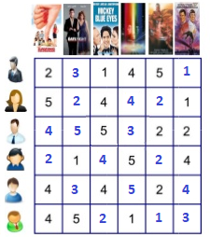
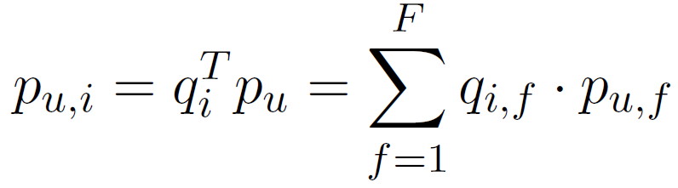
Collaborative Filtering and SVD
Core idea: Inspect rating patterns to find similar users/items.
Decomposition of ratings matrix R into the product of P & Q
Each user & item is described with F latent features
P: user factors
Q: item factors
factors
Prediction for user u about item i :
7

Slide 8
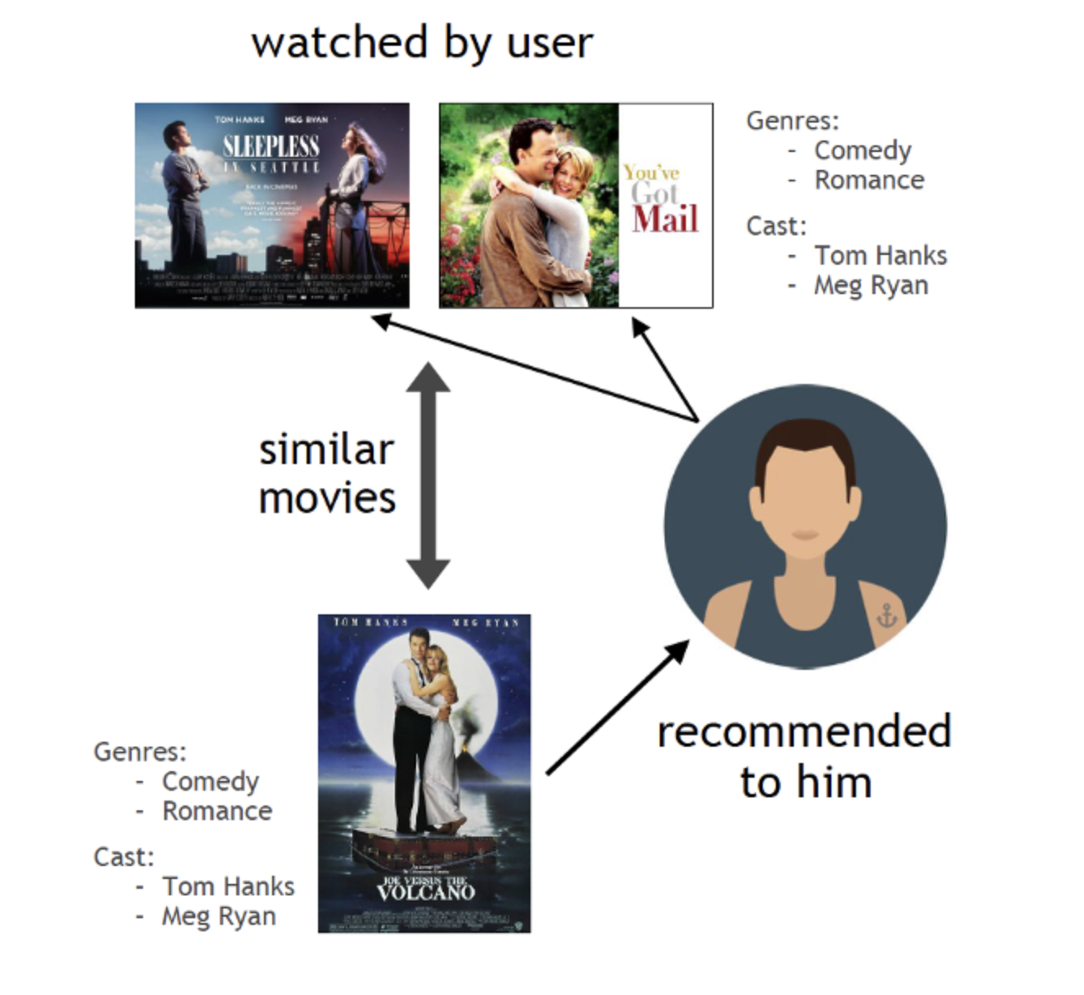
Accuracy-oriented Recommendation: Applied ML
Data
Model design
An optimization target

Slide 9
Wait… Listen to Users!
What do they really care about, the relevant order of a list, or whether those predictions are accurate?
Do you expect them to give ALL items they purchased a rating, so that you can start training? Even if yes, is that enough (unary feedback, missing-not-at-random)?
While doing evaluation with ratings, why do we only care about whether we predict the history well? Where are the comparison with those items that were never consumed?

Slide 10

How about Learning to Rank?
Query-document (Q-D) retrieval: Given a query, rank documents.
Relevant
features of a Q-D pair, relevance label
Irelevant
Irelevant
Irelevant
Learn a ranking function
Irelevant
Irelevant
Relevant
Predict relevances of new Q-D pairs
Relevant

Slide 11
How about Learning to Rank for Recommendation?
User-Item (U-I) retrieval: Given a query, rank documents.
Relevant
features of a U-I pair, relevance label
Irelevant
Irelevant
Irelevant
Learn a ranking function
Irelevant
Irelevant
Relevant
Predict relevances of new U-I pairs
Relevant

Slide 12
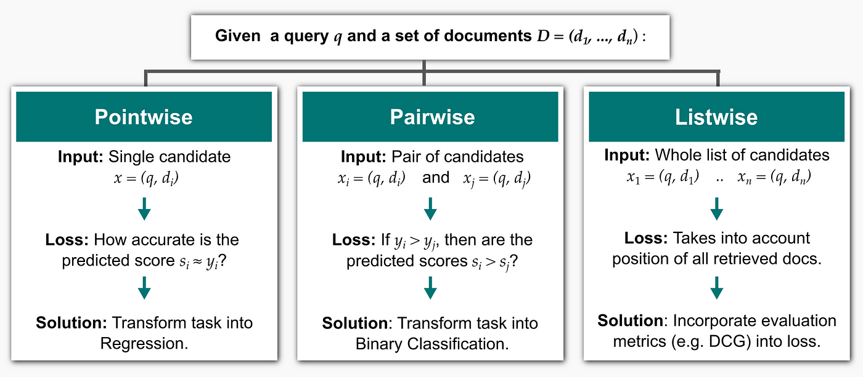
Learning to Rank for Recommendation: How?

Slide 13
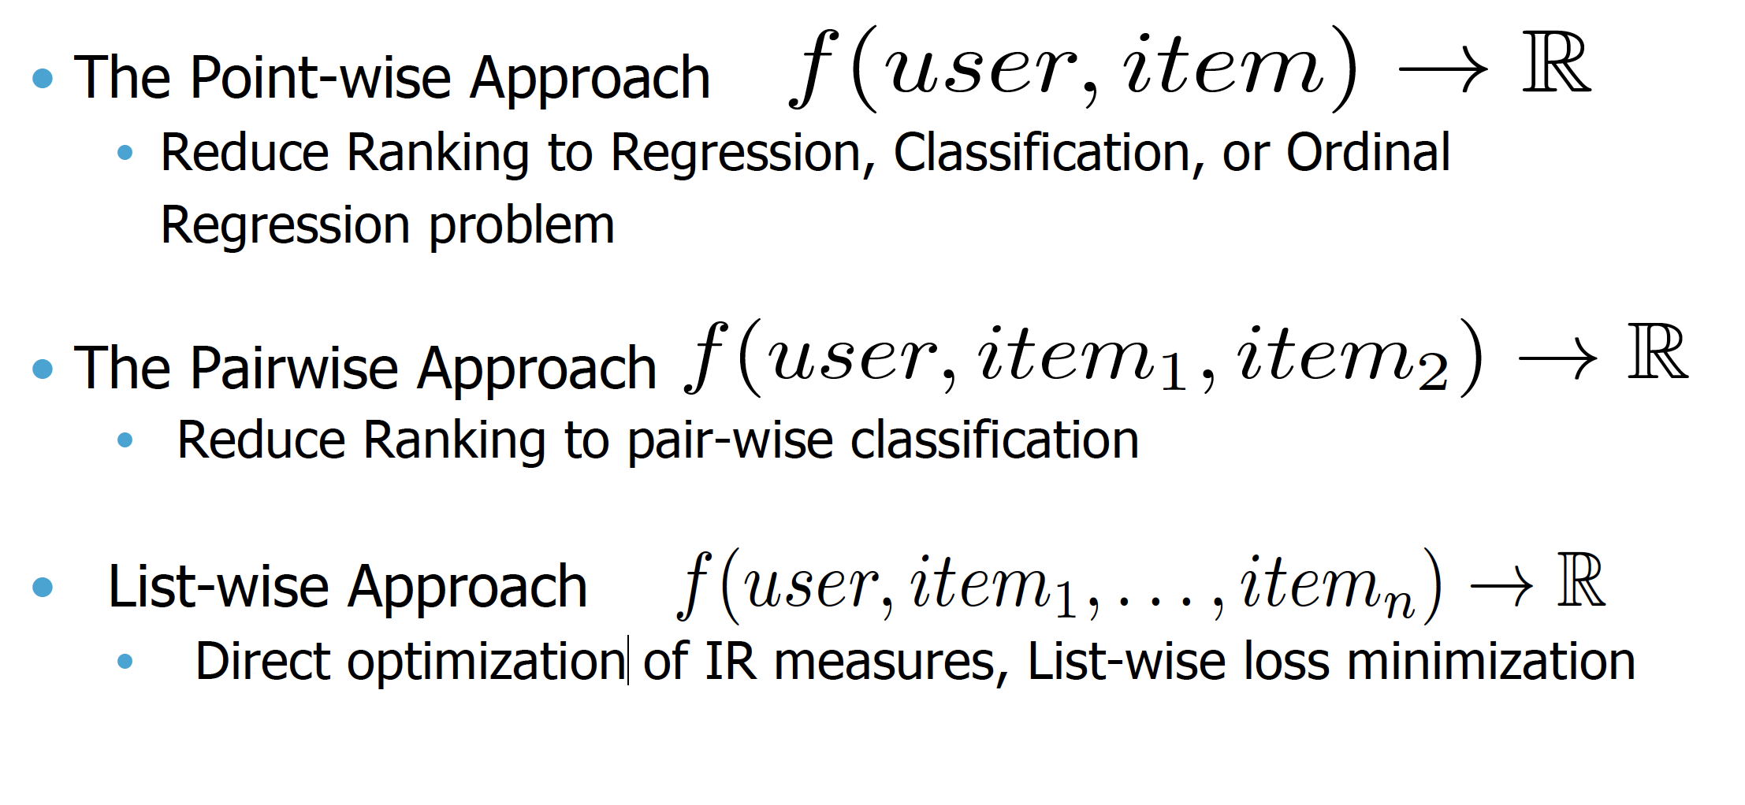
Learning to Rank for Collaborative Filtering

Slide 14
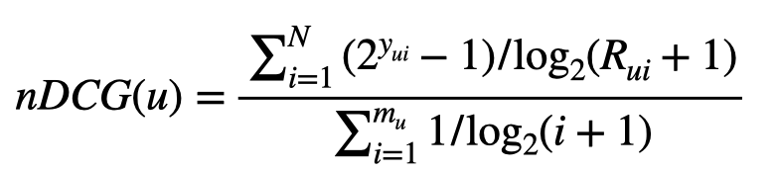
Promising but Troublesome Listwise Recommendation
More items to take care of, more computational resources needed;
Rank positions are discrete, and thus non-differentiable;
Which metric should I choose to optimize for?

Slide 15
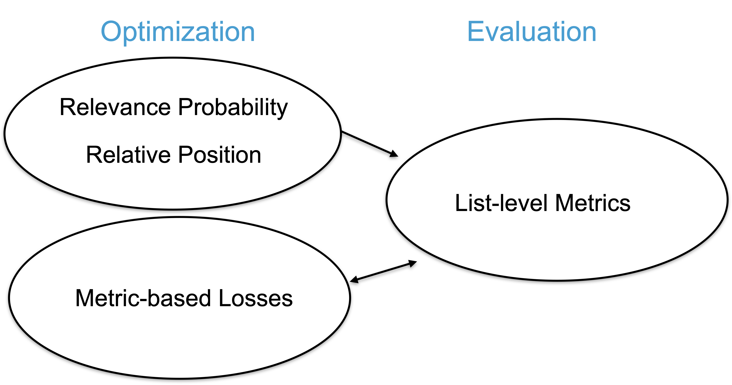

Slide 16
Optimizing for the Same Metric Used for Evaluation?
 | Evaluation Metric | Optimization Target
CLiMF (Shi et al, 2012) | RR | RR
TFMAP (Shi et al, 2012) | AP, Precision | AP
Top-N-Rank (Liang et al, 2018) | nDCG | DCG
LambdaRank （Burges et al, 2006） | nDCG | DCG

Slide 17
RQ1: In order to achieve the best possible accuracy for a broad population of users, should we optimize a recommender system for the criterion we would evaluate it on?

Slide 18
Concerns
Some metrics are more informative than others;
Metrics are correlated with each other to a different extent.
Notes:
From preliminary research in IR, informative
Different metrics correlate with each other in a different extent
if we evaluate on a metric not so informative, optimizing for another informative but badly correlated metric is unlikely to be a good idea
Inspired by this, we would like to conduct a thorough analysis on this topic

Slide 19
Problem
Goal: investigate the choice of metric to optimize for a recommender.
Given: {user, item, BINARY relevances}.
Target: Extensive comparison (effectivess, fairness, etc) on personalized recommendation lists to each user, optimized by different IR metrics.

Slide 20
Strategies
Pairwise (LambdaRank) and listwise methods for investigation;
Four metrics: nDCG, AP, RR, RBP;
Different data sparsities for training and testing.
Notes:
To conduct analysis, we consider two popular paradigms for metric-based optimization
Pairwise: classical method of lambdarank, which focuses on the loss caused by swapping the positions of relevant and irrelevant items
Listwise: smooth metrics to make them derivative
We analyze under different data distribution sparsities

Slide 21
Loss Design for Direct Optimization

Slide 22
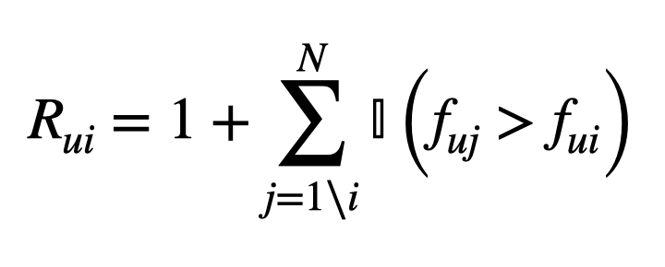
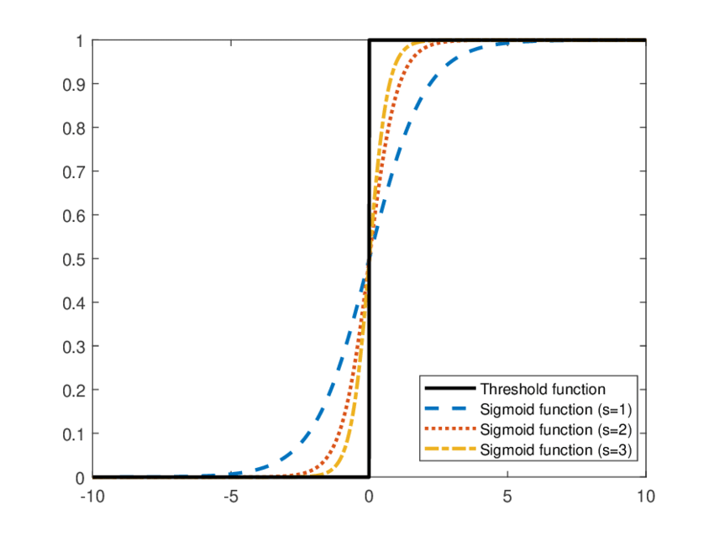
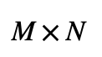
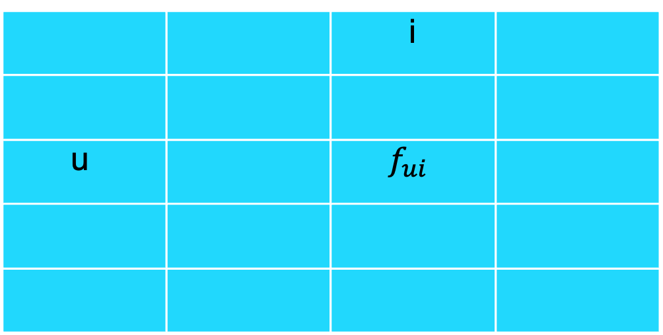
Make IR Metrics Smooth
 |  | i
u |  | $$f_{ui}$$
Indicator function to Sigmoid

Slide 23
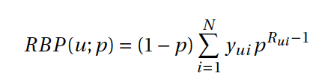
We Need Something More…
 | nDCG | AP | RR | RBP
LambdaRank | Donmez et al, 2009 |  |  | ?
Listwise | Top-N-Rank, Liang et al, 2018 | TFMAP, Shi et al, 2012 | CLiMF Shi et al, 2012

Slide 24
Optimizing for nRBP
 | nDCG | AP | RR | RBP
Range | [0, 1] | [0, 1] | [0, 1] | [0, <1]
DCG -> nDCG
RBP -> nRBP

Slide 25
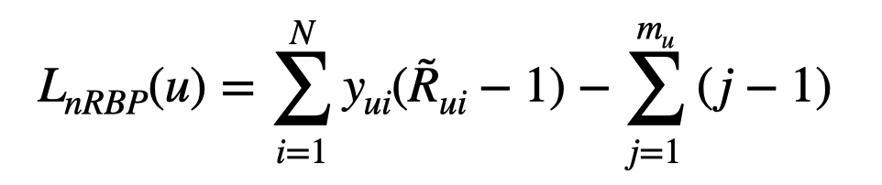
Optimizing for nRBP: Listwise
Optimize for an upper bound based on logarithmic transformation and Jensen inequality;
Independent of the hyperparameter p;
Lower bound = 0; upper bound not fixed;
Active users with more items are more important.

Slide 26
Experiments

Slide 27
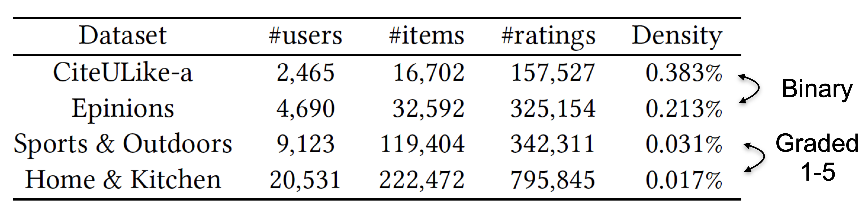
Datasets
Binarization: threshold=4 for graded datasets
25-core filtering
User-level split with Train:Test=4:1 (>=5 items per user for testing)

Slide 28
Protocols
3 different splits per dataset;
Evaluation Metrics: nDCG, AP, RR, RBP.8, RBP.9, RBP.95
Recommender: Matrix Factorization (SVD)
Negative Sampling Ratio (NSR): 100%, 200%, 500%
Training Checkpoint Selection for listwise nRBP is based on the optimal performance value of different p’s.

Slide 29
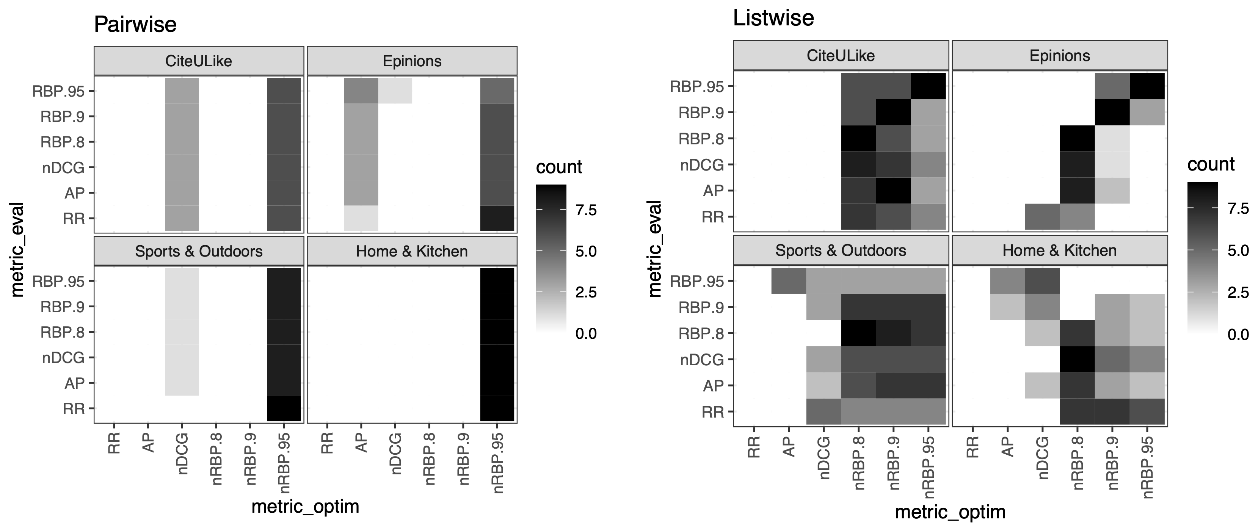
Overall Performance

Slide 30
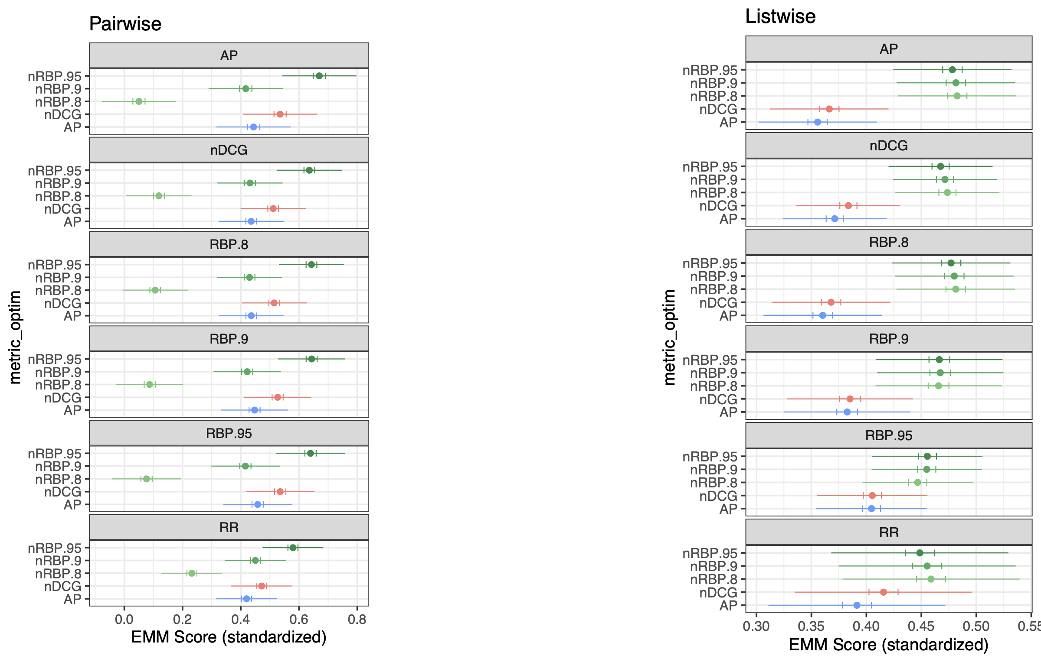
Overall Effectiveness: by Metrics Used for Optimization
Notes:
Expected marginal mean
standardized

Slide 31
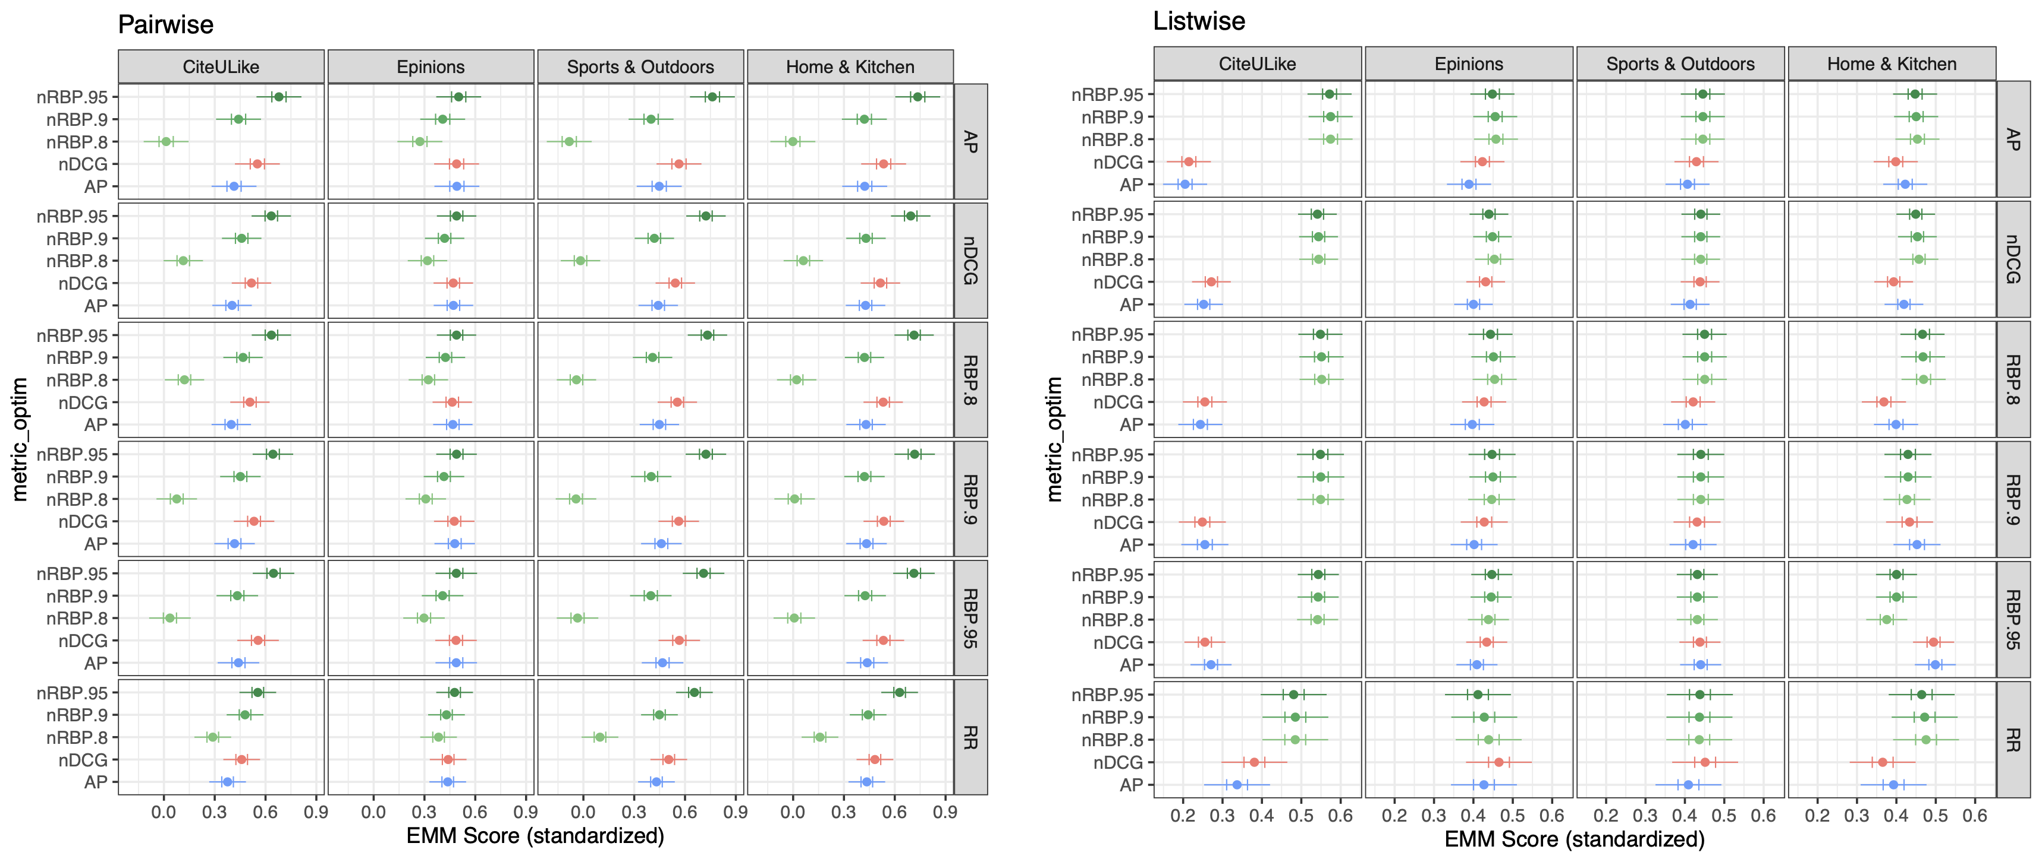
Overall Effectiveness: by Datasets
Notes:
Expected marginal mean
standardized

Slide 32
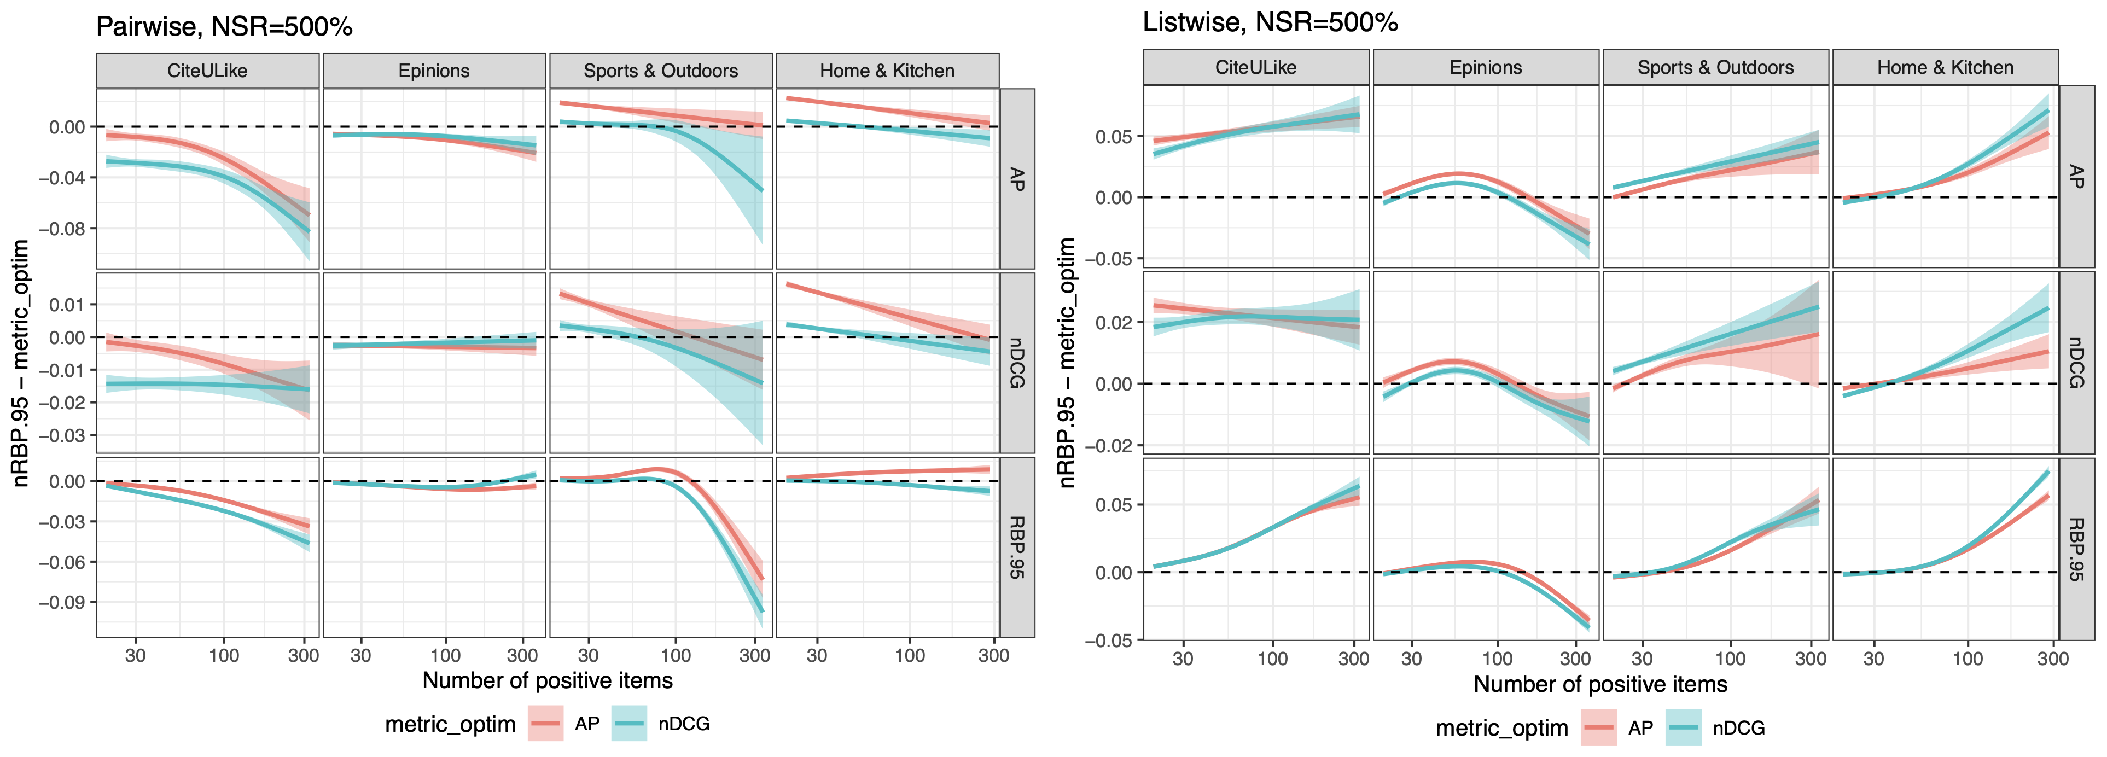
Invididual Analysis on nRBP: Fairness for Effectiveness?
Notes:
Pairwise: strict upper bound; inactive users perform better than active counterparts;
Listwise: upper bound not fixed; favors active users; tends to improve everywhere, but larger for active users; indeed unfair, but not at the cost of sacrifice inactive users

Slide 33
Insights
It is not necessarily the best to optimize for the same metric used for evaluation in ranking-based recommender systems;
There is one metric, namely RBP, to be a promising alternative to serve as the optimization target;
The RBP-inspired optimization target improves the utility of both active and inactive users, but favors more on active users.
Roger Zhe Li, Julián Urbano, and Alan Hanjalic. “New Insights into Metric Optimization for Ranking-based Recommendation”. In: SIGIR. ACM, 2021, pp. 932–941

Slide 34

Reflection: Is Average Enough?

Slide 35
Similarity, Are We Going Too Far?
Non-mainstream users

Slide 36
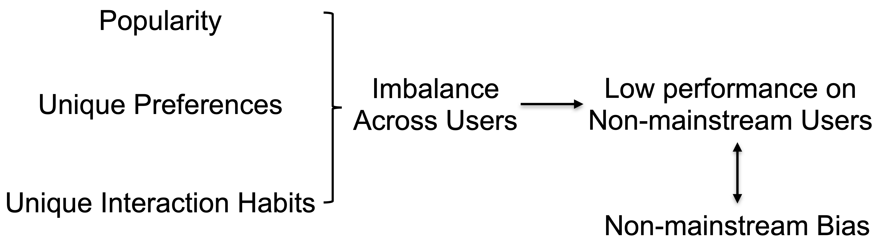
Bias in CF-based Recommendation

Slide 37
RQ2: How to mitigate the mainstream bias in recommender systems, so that different users or user groups share a more balanced recommendation accuracy?

Slide 38
Pathways on Mainstream Bias Mitigation
How to help
Introduce more data for user modeling
Direct intervention to non-mainstream users
Mainstream Bias
Who to help
Knowing who is non-mainstream

Slide 39
Methodology: How to Help
No clear idea on who to help, and also no need for a clear quantified definition of mainstreamness;
Model users/items with more abundant data;
Enforce the intrinsic user properties to be preserved and not to be fully driven by similarity-based modeling.

Slide 40
Problem
Goal: mitigating the non-mainstream bias;
Given: explicit ratings; content-based side information;
Target: A personalized recommendation list to each user, achieving a better balance across all users in recommendation.

Slide 41
How to Utilize the
Content-based Side Information?

Slide 42
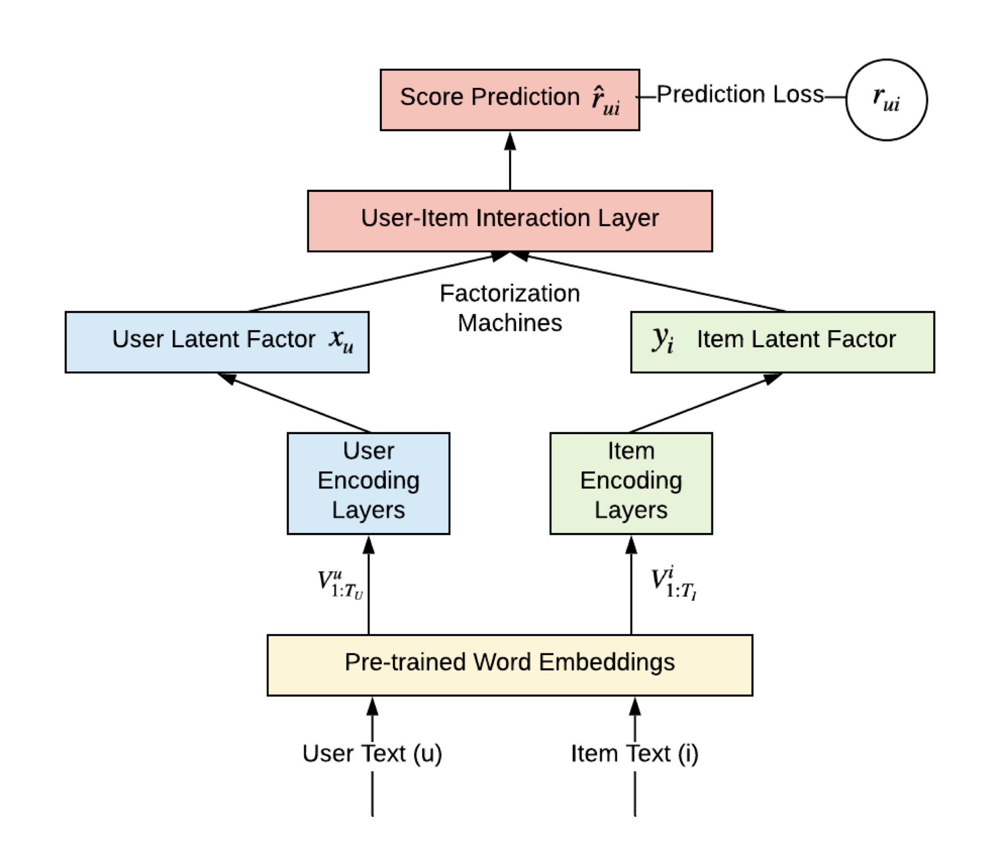
DeepCoNN: Preliminary Model
Zheng, Lei, Vahid Noroozi, and Philip S. Yu. "Joint deep modeling of users and items using reviews for recommendation." Proceedings of the Tenth ACM International Conference on Web Search and Data Mining. ACM, 2017

Slide 43
How to Provide
the Adversarial Power?

Slide 44
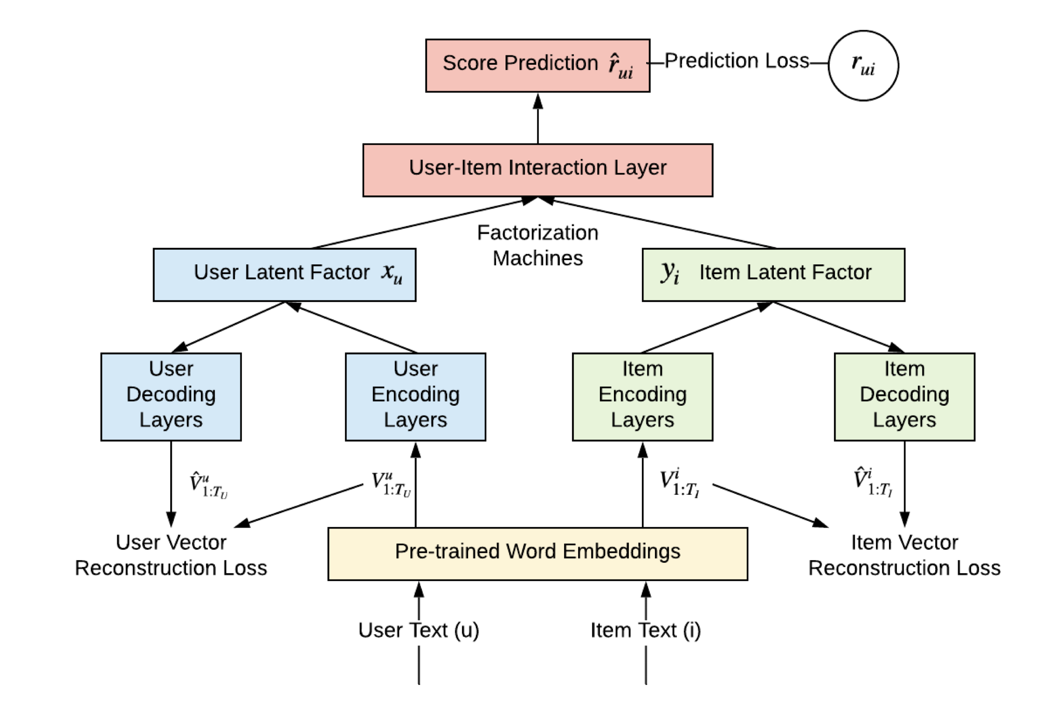

NAECF: Debiasing for Non-Mainstream Users

Slide 45
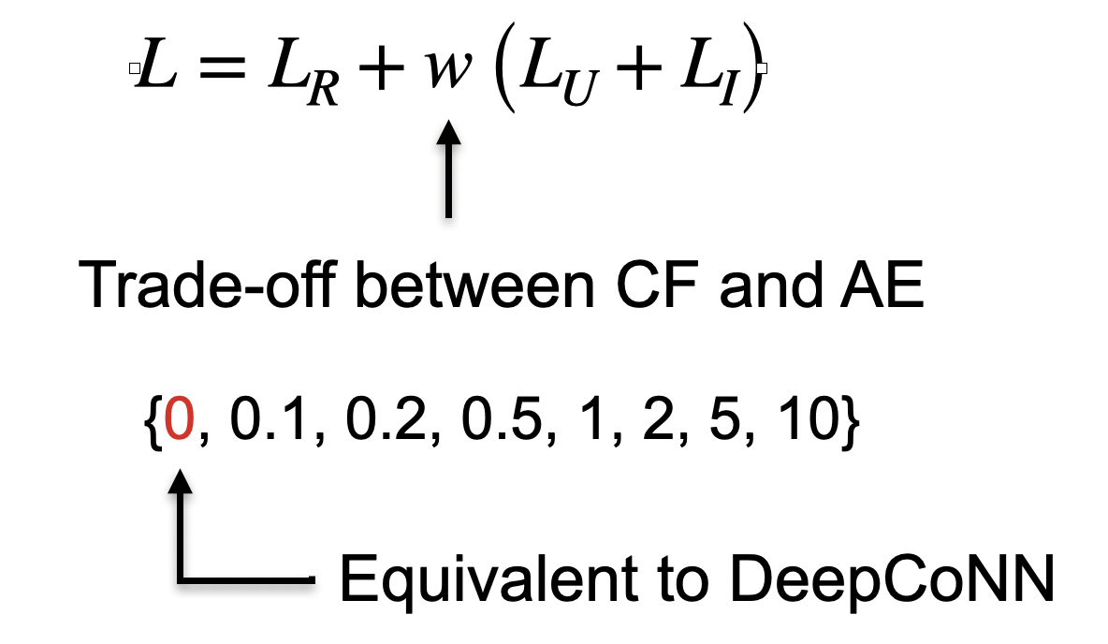
Model Learning: Overall Loss
The overall loss function is the linear combination generated from CF (rating prediction) and AE (text reconstruction).

Slide 46
Model Learning: Overall Loss
The overall loss function is the linear combination generated from CF (rating prediction) and AE (text reconstruction).

Slide 47
How to Evaluate
the Balance across Users?

Slide 48
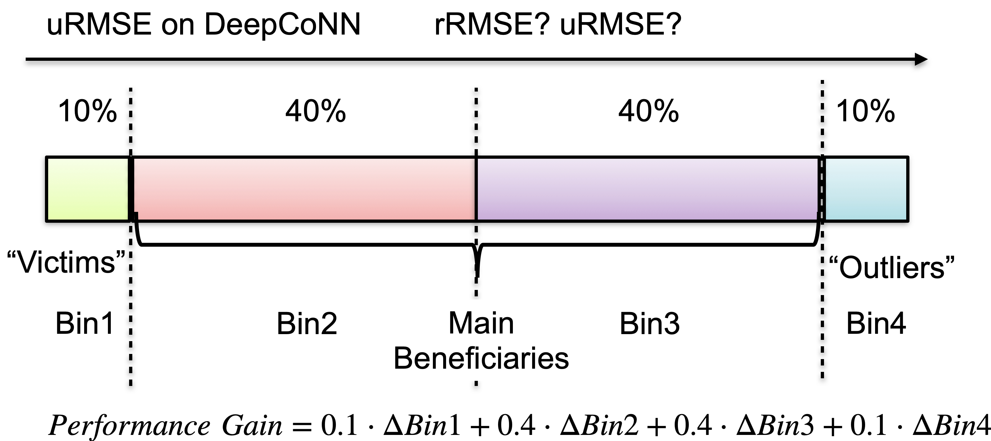
Individual User Investigation: AutoEncoders

Slide 49
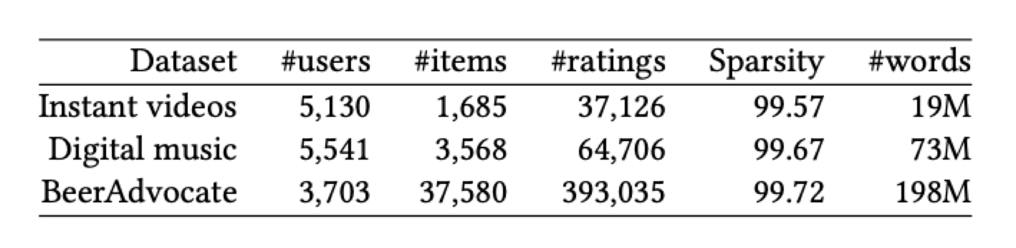
Experiments: Datasets & Baselines
Train: Validation: Test = 8:1:1
10 different splits per dataset
Core Evaluation Metric: rRMSE, uRMSE
Each user has at least 5 ratings
Baselines: MF and DeepCoNN

Slide 50
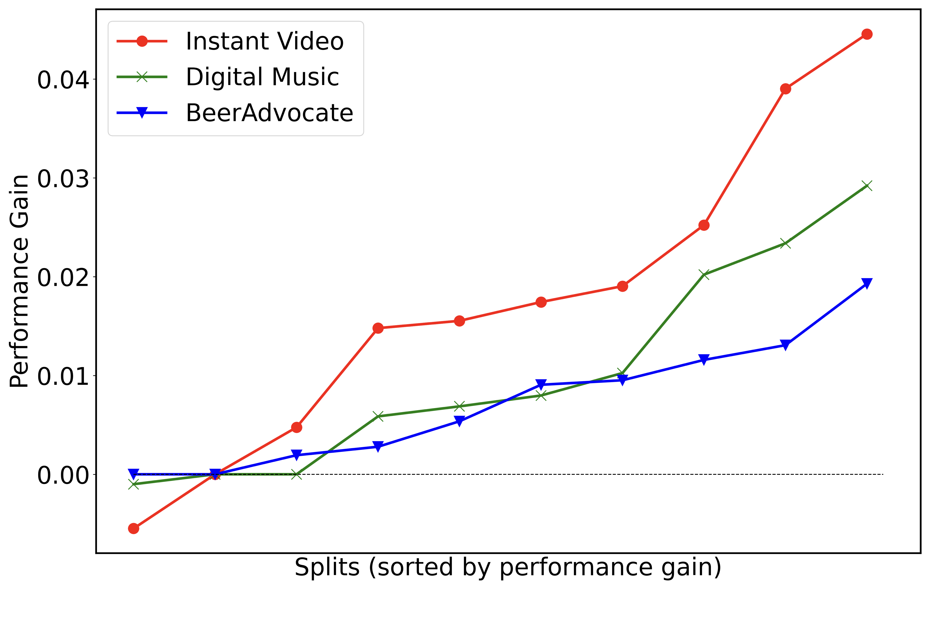

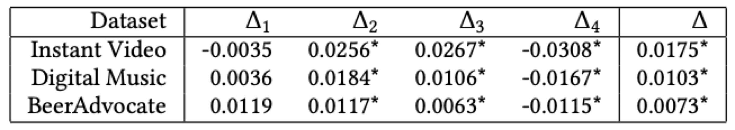
Individual User Investigation: AutoEncoders
NAECF improves the utilities of non-mainstream users WITHOUT significantly hurting mainstream users.

Slide 51
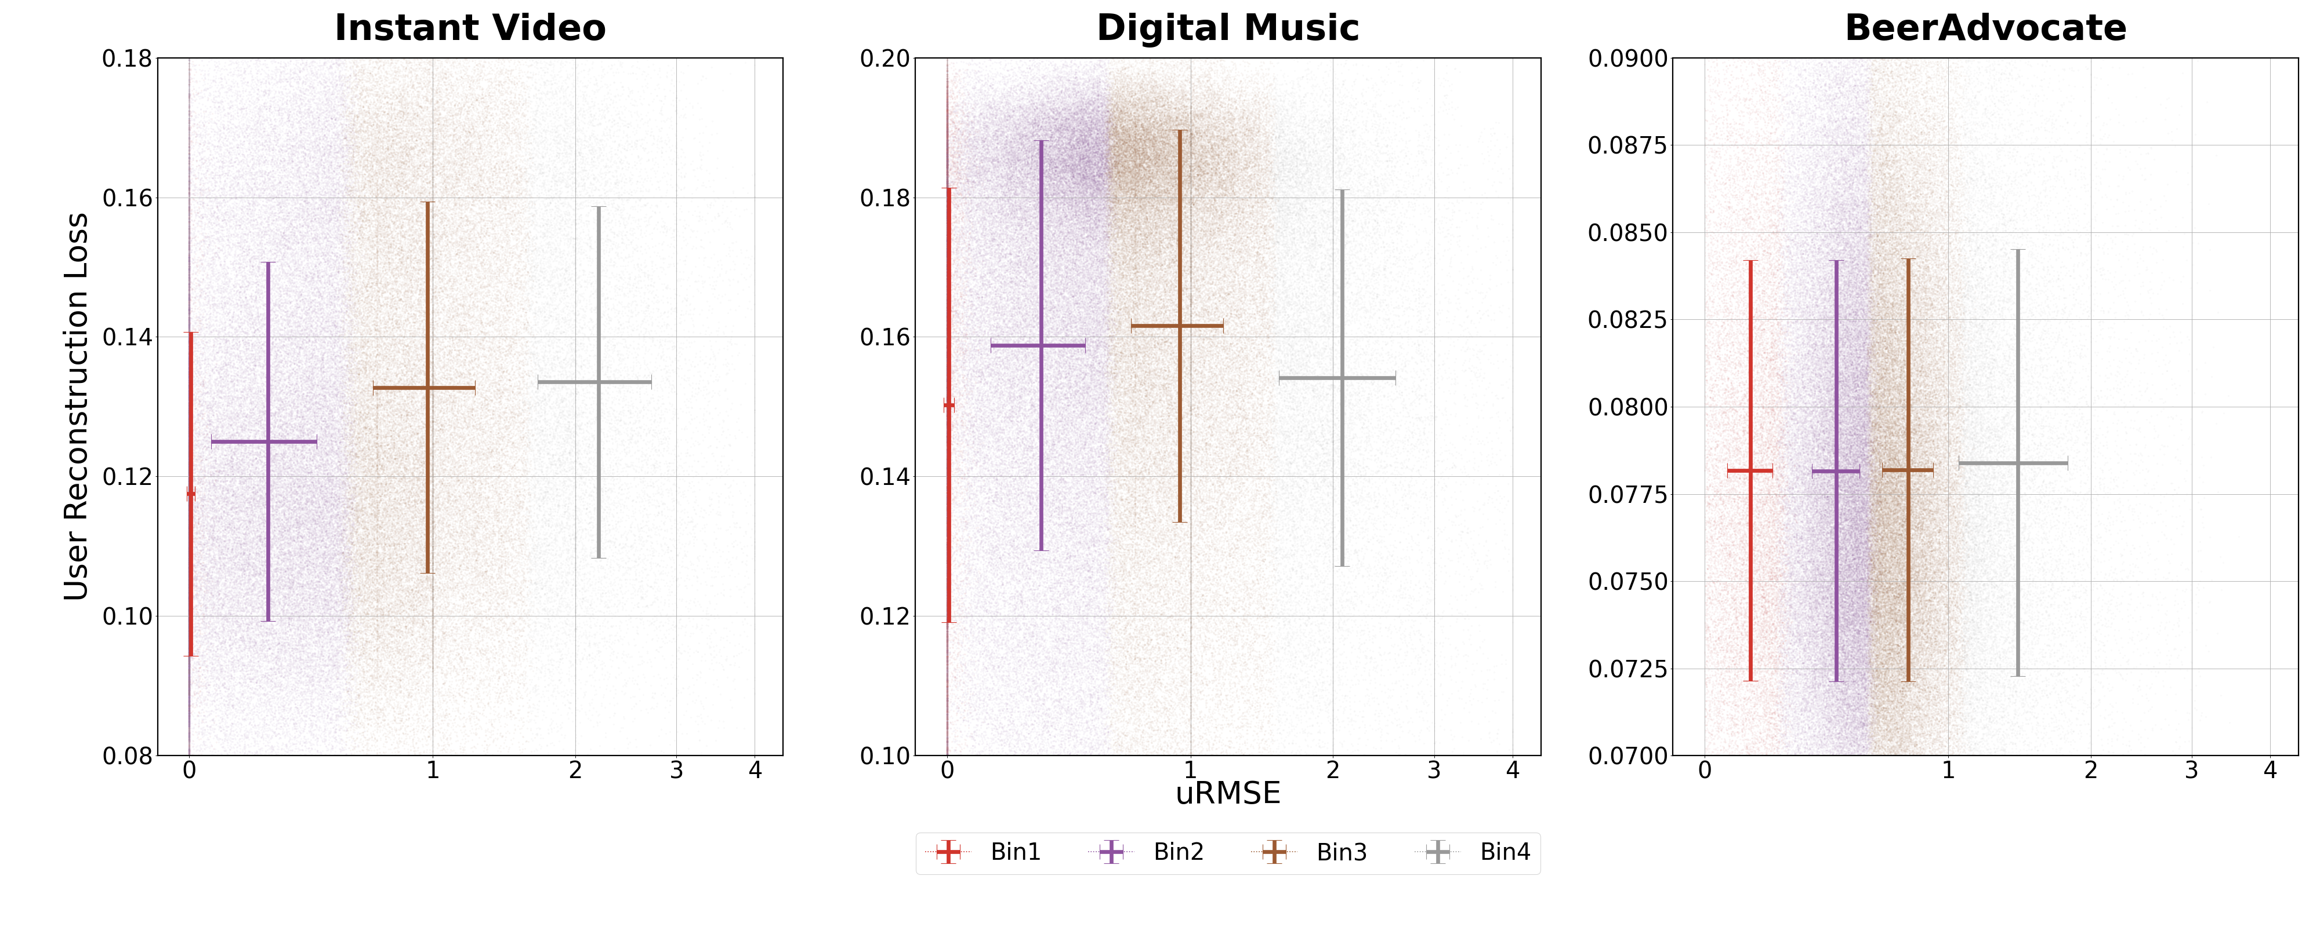
Individual User Investigation: Mechanisms
The vectors of mainstream users are easier to reconstruct.

Slide 52
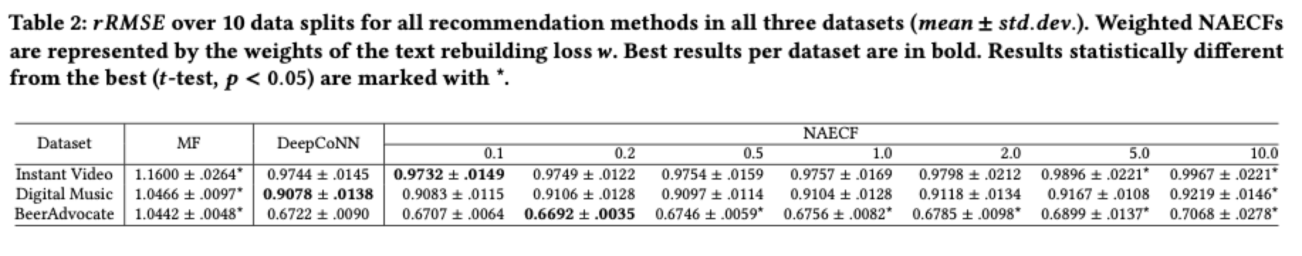
Experiments: Overall Results
Review features help achieve a significant improvement over pure MF;
NAECF with a mild CF-AE trade-off does NOT bring a significant rRMSE loss.

Slide 53
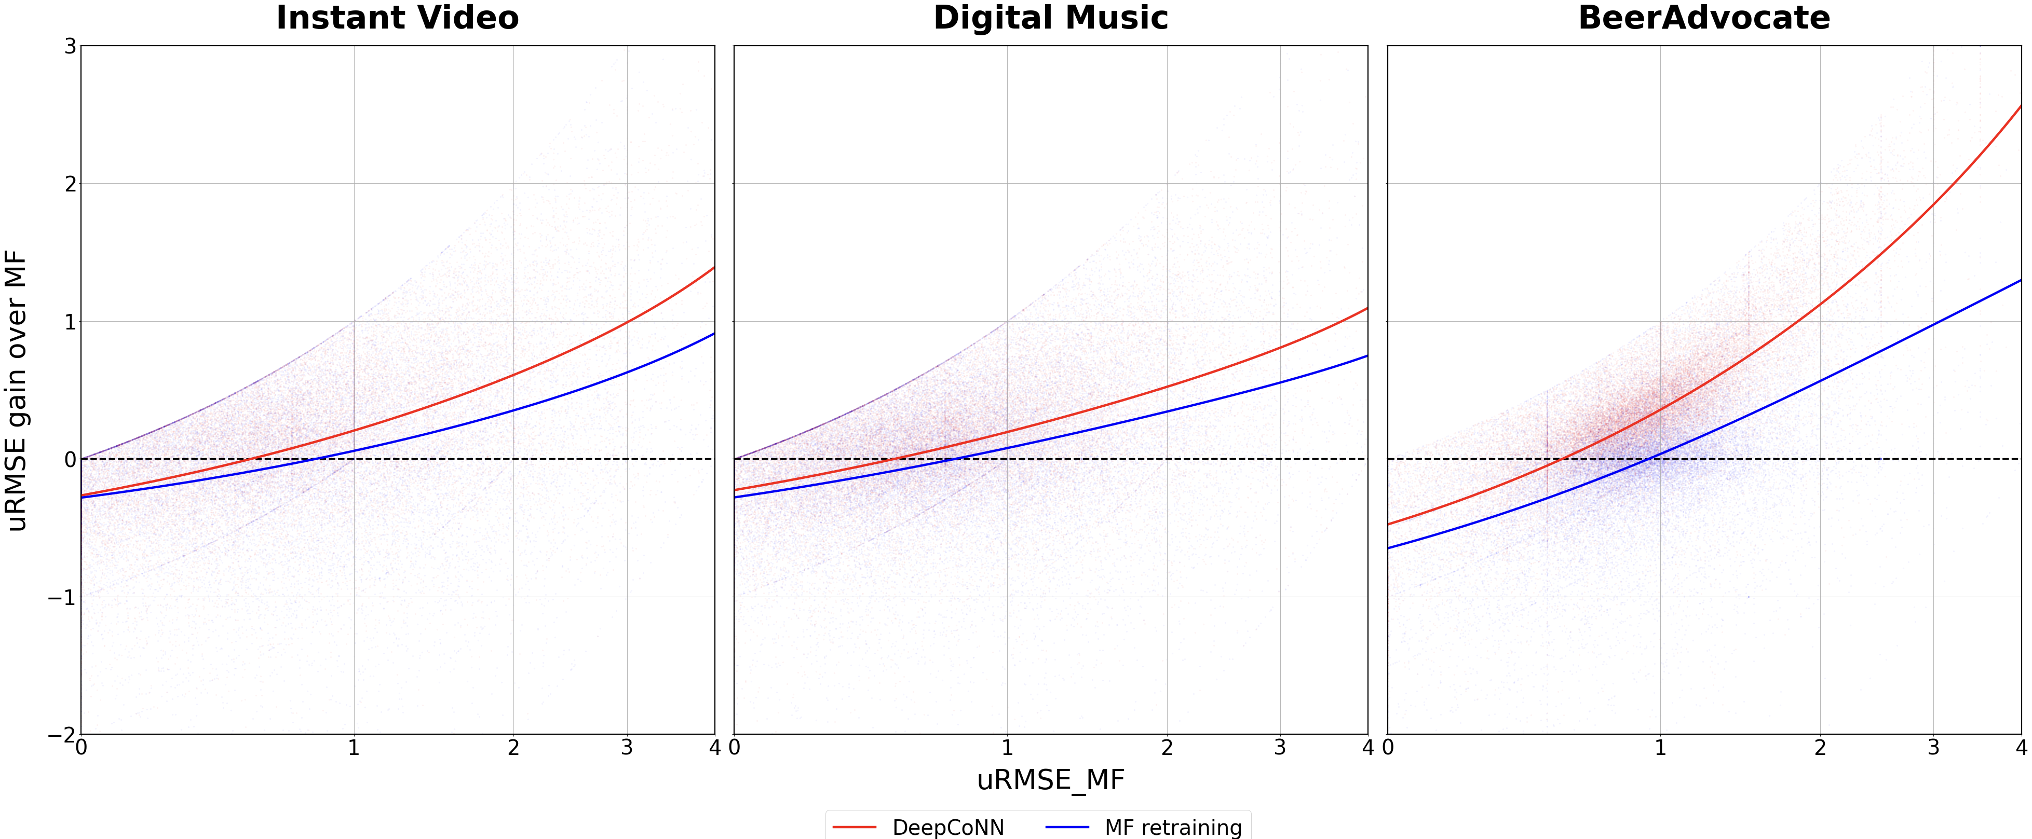
Individual User Investigation: Reviews
Review features help achieve a significant improvement over pure MF on user balance.

Slide 54
Insights and Reflections
Both abundant data and intrinsic property preservation work out: non-mainstream users who suffer in vanilla recommendation models receive better recommendation accuracy in general;
There are still 10% users in the far long tail we cannot effectively help;
We worked on how to help, but not who to help.
Roger Zhe Li, Julián Urbano, and Alan Hanjalic. “Leave No User Behind: Towards Improving the Utility of Recommender Systems for Non-mainstream Users”. In: WSDM. ACM, 2021, pp. 103–111

Slide 55
How to Resolve the Question
“Who to Help”?

Slide 56
Methodology: Who to Help
A clear definition of mainstreamness is still tricky;
Accuracy on a traditional recommender as a powerful proxy of mainstreamness;
Increase the cost of not treating non-mainstream users well.

Slide 57
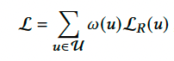
Intuition on Direct Intervention: Cost-sensitive Importance

Slide 58
Intuition on Direct Intervention: Cost-sensitive Importance
HOW TO DEFINE?

Slide 59
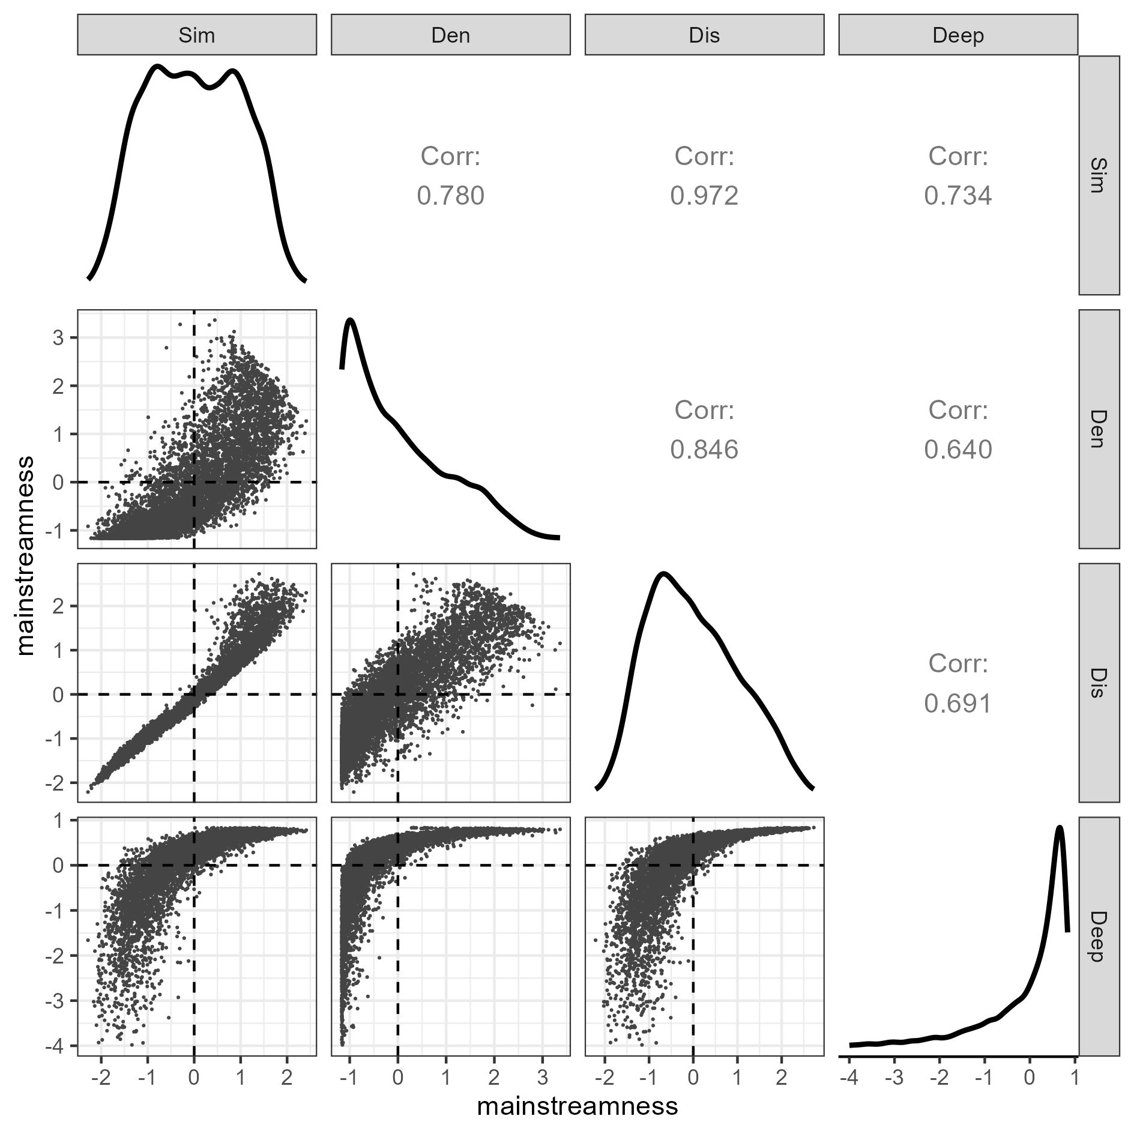
Option 1: Explicit Measure/Quantify Mainstreamness
Multiple different definitions;
Inconsistency of user mainstreamness identification;
Should the measurement of mainstreamness be model-agnostic?
Zhu, Ziwei, and James Caverlee. “Fighting mainstream bias in recommender systems via local fine tuning.” In WSDM 2022.

Slide 60
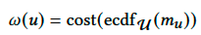
Option 2: Get a Proxy of Mainstreamness
Expected outcome of mainstream bias: non-mainstream users suffer lower recommendation accuracy;
Bias is intrinsic, but pronounced by the model.
Empirical Cumulative Distribution Function
Recommendation accuracy

Slide 61
Experiments & Results

Slide 62
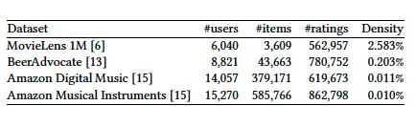
Datasets & Baselines
Binarization: all ratings are regarded relevant;
FM as the model to get m_{u};
nDCG as the metric to measure m_{u};
Always with at least 5 items per user for train/val/test. Datasets are evenly split;
Baselines: FM and one of the four model-agnostic strategies (Sim);
Measure the recommendation performance in 5 buckets, as per the Sim or nDCG (Util) scores on vanilla FM models. Lowest nDCG scores are interpreted as least mainstream, and higher nDCG scores mean more mainstream.

Slide 63
Effectiveness of Accuracy as Mainstreamness Proxy

Slide 64
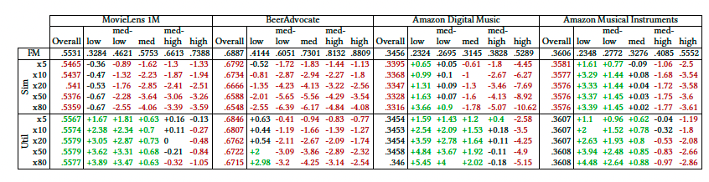
Effect of Bias Mitigation: Split by User Accuracy (Util)

Slide 65
Effect of Bias Mitigation: Split by User Accuracy (Util)

Slide 66
Discussion: Are the Results on the Individual User Level Reliable?

Slide 67
Data for producing reliable results on the indivisual user level
Enough items for each user to be well trained;
Enough items for validation/evaluation;
Achieve higher user coverage.

Slide 68
Insights
Direct intervention by focusing more on non-mainstream users can help mitigate mainstream bias;
User recommendation accuracy on a traditional recommendation model is an implicit but effective proxy of mainstreamness;
The reliable results on the research of individual user performance are subject to sufficient data for training/validation/testing.
Roger Zhe Li, Julián Urbano, and Alan Hanjalic. “Mitigating Mainstream Bias in Recommendation via Cost-sensitive Learning”. In: ICTIR. ACM, 2023, pp. 135–142

Slide 69
Future Directions
Choice of metrics for optimization: binary feedback -> scale feedback?
Exploration vs. Exploitation: should we always optimize for one single metric to the end?
How to define mainstreamness effectively and quantitatively? Do we need disentanglement methods?
Mainstreamness should have been DYNAMIC!
Potential one-stage and/or pre- and in-processing for mainstream bias mitigation.

Slide 70


